Slide 1
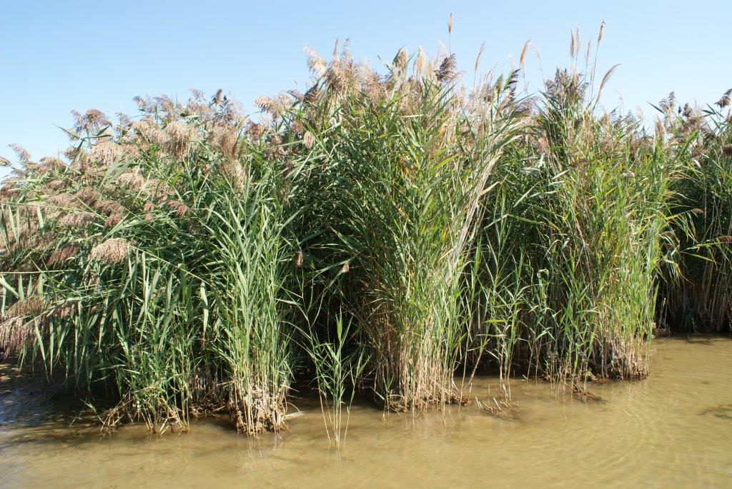

Application Technology
Phragmites Eradication
Steve Ford, President
Website: www.green-stream.ca
Advanced Vegetation Management

Slide 2
INTRODUCTION
As many of you are aware, there are many ways that allow Invasive Phragmites to spread across Ontario and other provinces.
The spread vector that I am speaking to today is the roadside transportation method.
For many years we have been able to identify, map and develop control strategies. My discussion today is going to be focusing on what control method Municipalities have been using to help reduce the spread and control Phragmites.
As many of us are aware, there are different ways of helping to reduce Phragmites:
Rolling, Burning, Cutting, Drowning and Herbicide Application
I will be speaking about Cutting and Herbicide Application.
Website: www.green-stream.ca

Slide 3
Cutting Control Method
Cutting application method have been utilized by many local municipalities throughout south western ontario.
Cutting the phragmites allows the standing dead material to be mulched up and removed thus reducing the fire risk, wildlife and vehicle collisions, as well as allowing for a more effective herbicide application.
By cutting the dead material in the non growth months such as Nov-April, it will allow all new growth to be exposed and not hidden from the dead material, thus it will allow for more herbicide material to reach and penetrate the plant and reducing the excess herbicide material from landing on the dead stock. Cutting will also help reduce the vigor of the phragmites and slows down it’s regrowth.
Website: www.green-stream.ca

Slide 4
Cutting Methods for Roadsides
Side Mount Boom Mower:
We have utilized a side mount boom mower of various lengths such as 24, 30 and 38 Feet in reach.
We have found that the most effective type of mower is a fixed rotary type as opposed to a drum type of mulcher.
The speed of the application largely depends on a combination of things:
Density of the Phragmites Mass
Expected Level of Phragmites Mulching
Number of Passes Required
Traffic Control
Website: www.green-stream.ca

Slide 5
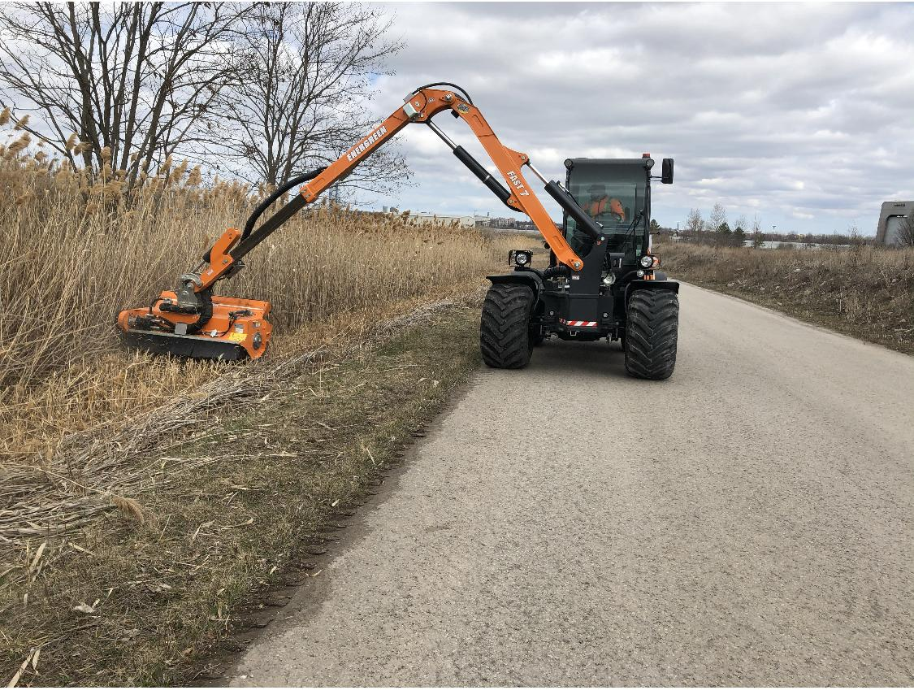
38’ Boom with flail
Website: www.green-stream.ca

Slide 6
Cutting Methods for Roadsides
Rear Mount Side Shift Flail Mower:
We have utilized this method when Phragmites cutting has been added to grass cutting contracts. Many roads are narrow enough that a farm tractor with a rear mount mower has enough reach to get the Phragmites closest to the road.
Factors affecting this applications level of effectiveness:
Width is an issue. Reach limitations
Flail type mower is effective, but not as effective in my experience
More of an off road approach required
Website: www.green-stream.ca

Slide 7
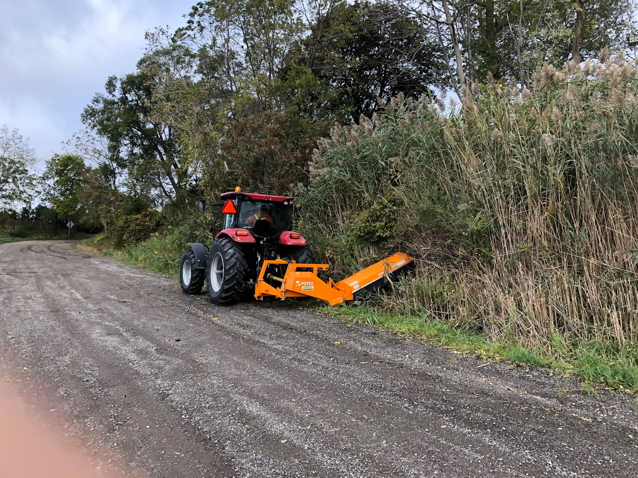
Rear Flail
Website: www.green-stream.ca

Slide 8
Cutting Methods for Roadsides
Track Loader or Remote Control Mower:
This is another very effective yet site specific method. A large track loader with a rotary mower attachment provides the ability to mow in very unstable terrain. We have found that a tracked loader with rotary head is the most efficient way to mow Phragmites in large open areas.
There are also remote control operated mowers that can be used on heavy slope environments with good traction to cut and mulch the Phragmites where employee operation is not feasible or safe.
Website: www.green-stream.ca

Slide 9
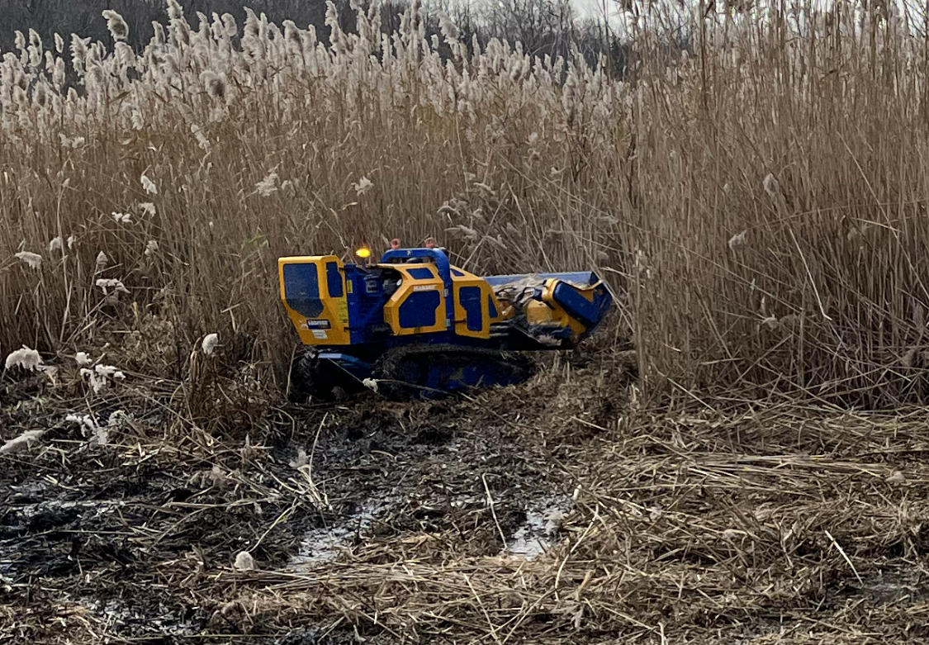
Remote Control Mower
Website: www.green-stream.ca

Slide 10
Roadside Herbicide Application
The most practical way to to treat Phragmites along roadsides is by using spray trucks that provide the proper rate of application and have the capacity to treat large areas in order to maximize efficiencies.
There are times when a blanket spray approach is the only real effective option, and then there are times where a direct treatment approach is necessary like hose and handgun or backpack spray applications.
The main thing is to make sure that the licensed applicator who will be doing the spraying, will be caring it out in a safe way with men at work signs and following all of the proper Book 7 practices regarding traffic control. Working around the public is also challenging, so extra caution and awareness is required.
Website: www.green-stream.ca

Slide 11
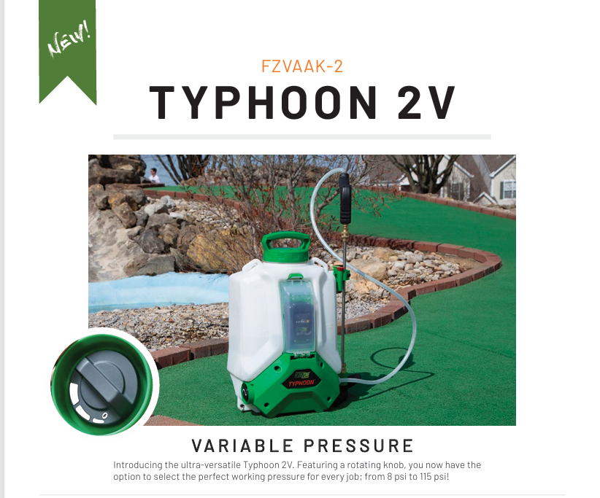
Backpack Sprayer
Website: www.green-stream.ca

Slide 12
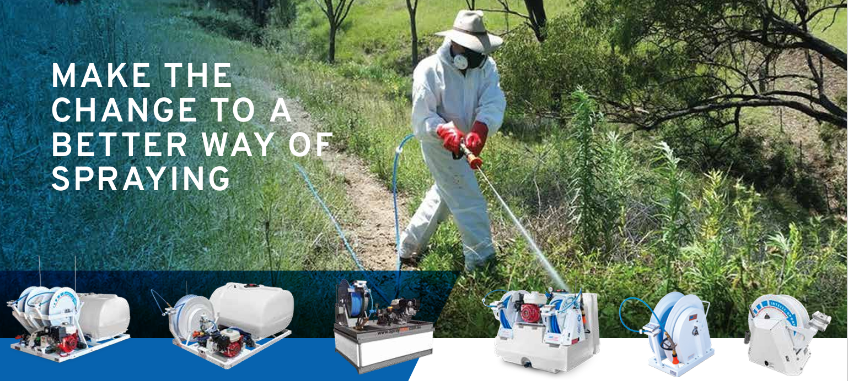
Hose and Handgun Equipment
Website: www.green-stream.ca

Slide 13
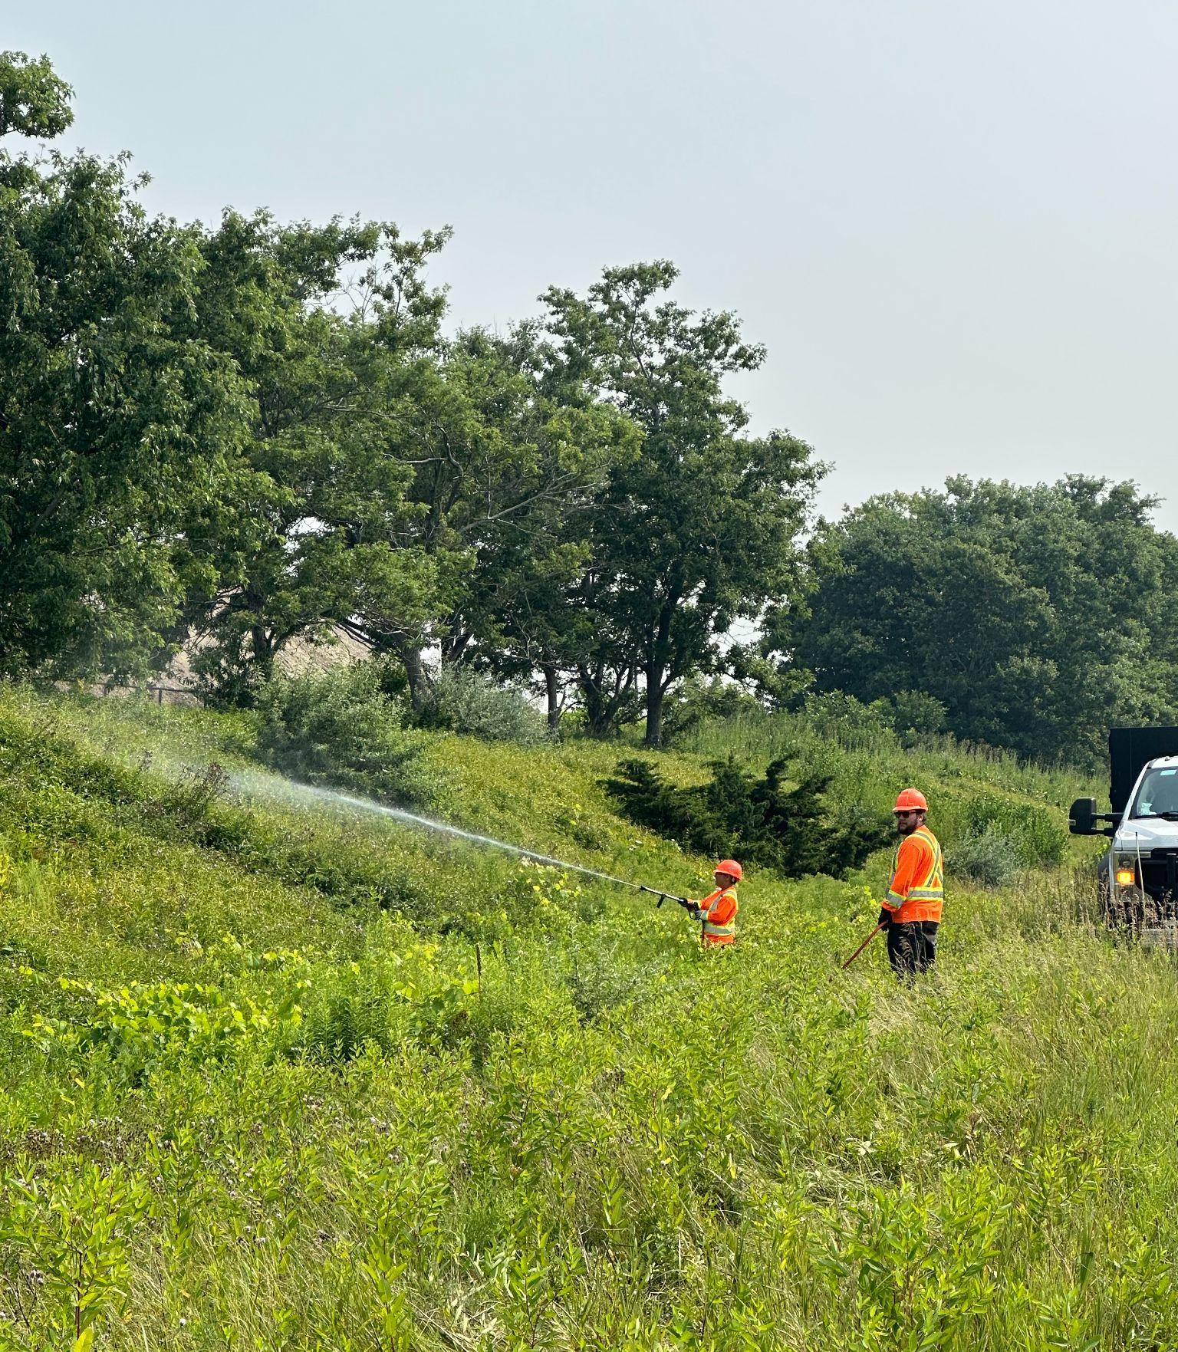
Roadside Application
Website: www.green-stream.ca

Slide 14
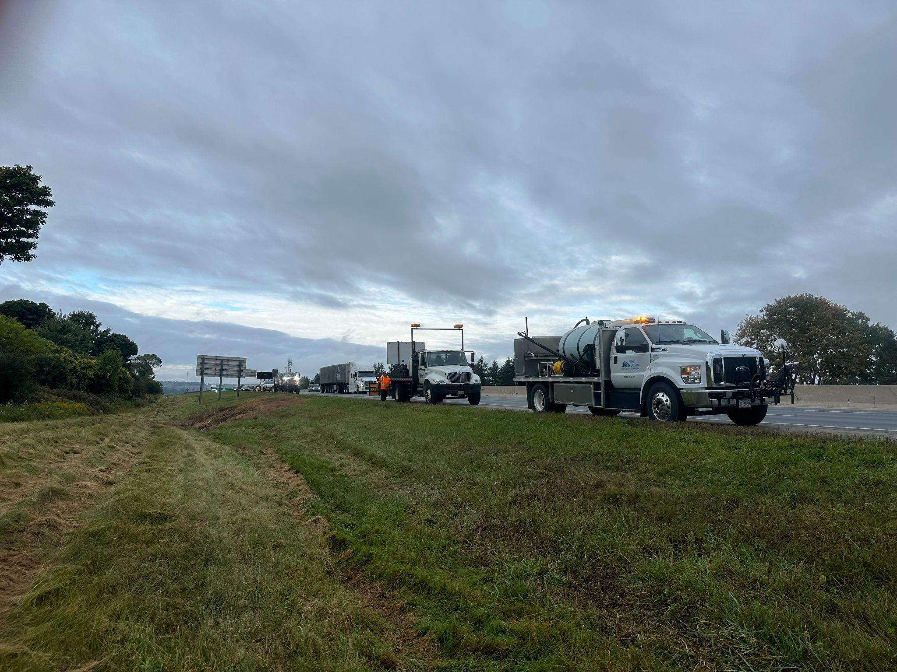
Roadside Application
Website: www.green-stream.ca

Slide 15
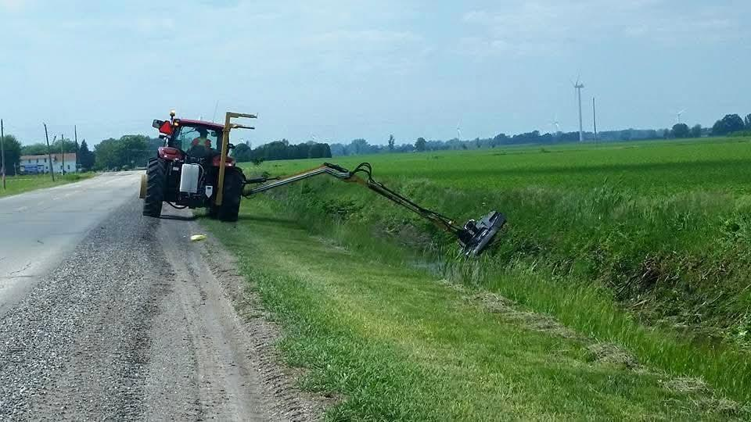
Ditch Mowing Phragmites with Wet Blade
Website: www.green-stream.ca

Slide 16
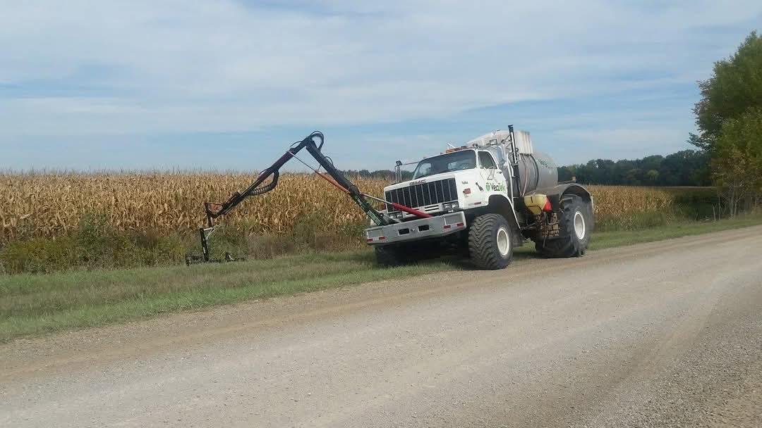
Ditch Spraying Application
Website: www.green-stream.ca

Slide 17
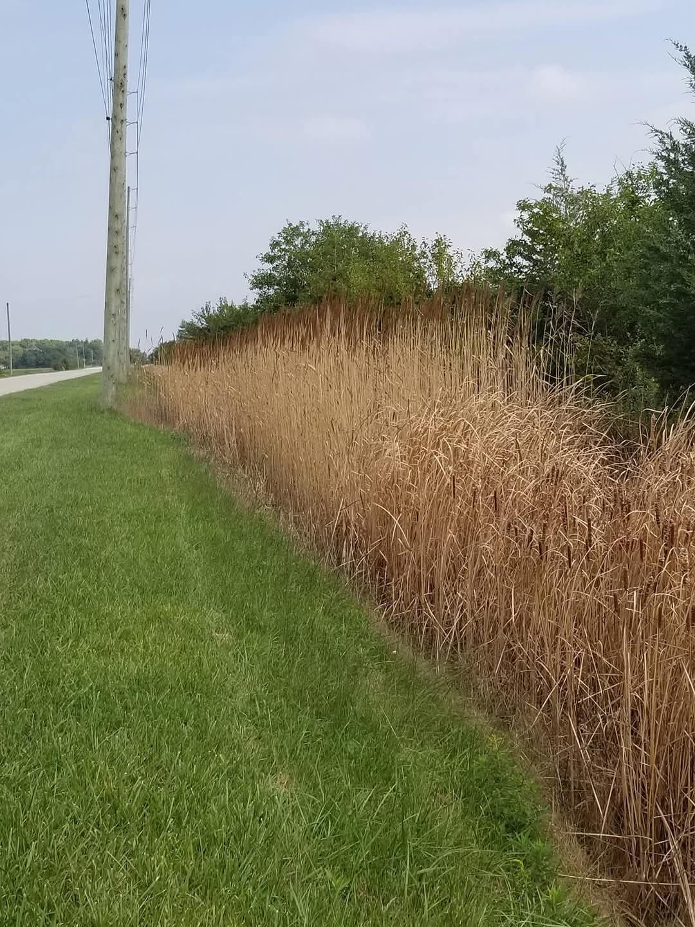
Ditch Application Results
Website: www.green-stream.ca

Slide 18
Raven Viper 4 Plus Field Computer
Bing Videos

Slide 19
STA Logger
https://youtu.be/tybCFKDbsi8

Slide 20
Questions ?
Thank You for allowing me to present
Steve Ford, President
sford@green-stream.ca
Cel: 905-802-3347
Website: www.green-stream.ca

