Slide 1
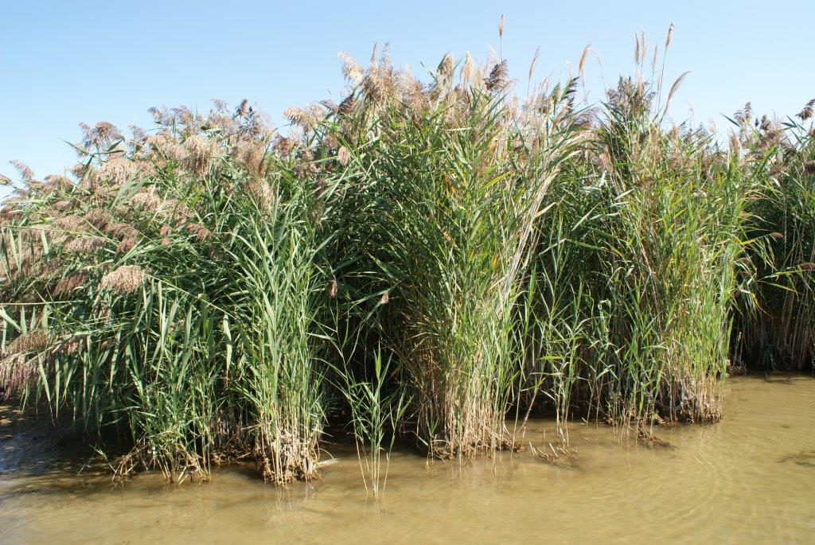

Tendering Guideline Discussion
Phragmites Eradication
Steve Ford, President
Website: www.green-stream.ca
Advanced Vegetation Management

Slide 2
Sample Tender (RFP)
RFQ - Herbicide Control of Roadside Phragmites

Slide 3
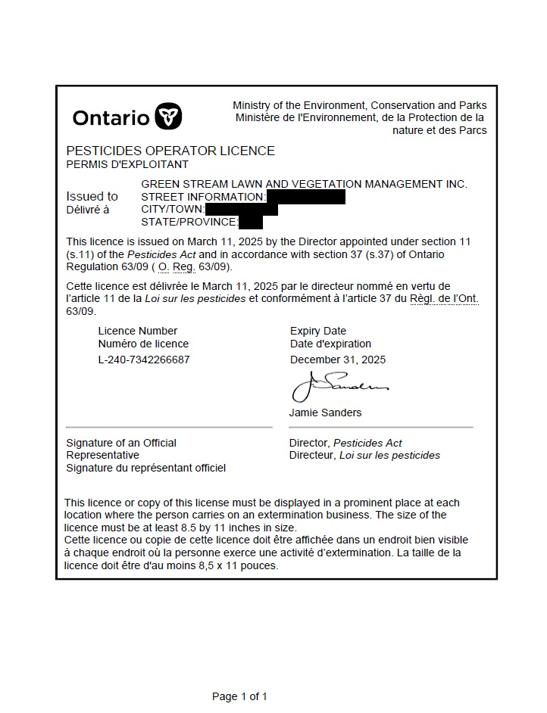
Qualifications- Operators License

Slide 4
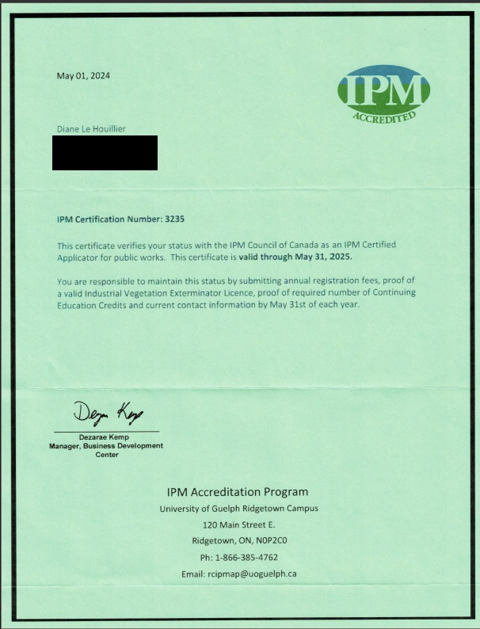
Qualifications- IPM Certified Agent

Slide 5
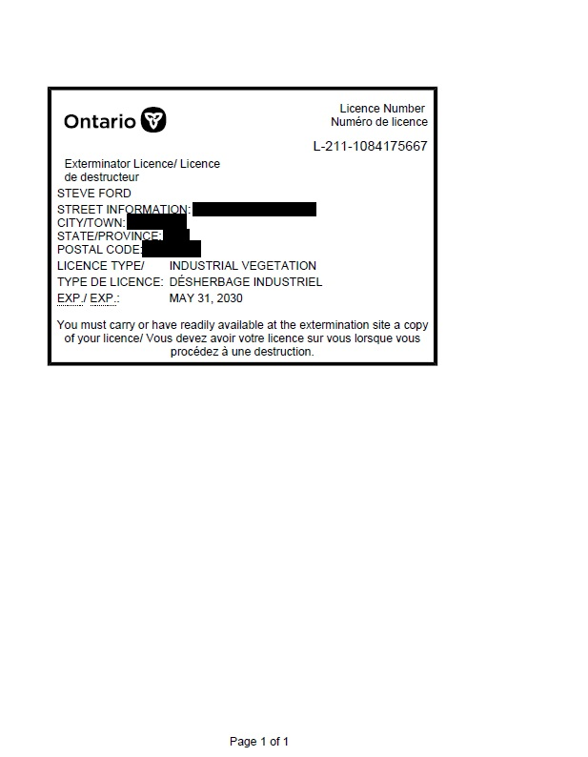
Quailfications- Industrial License

Slide 6
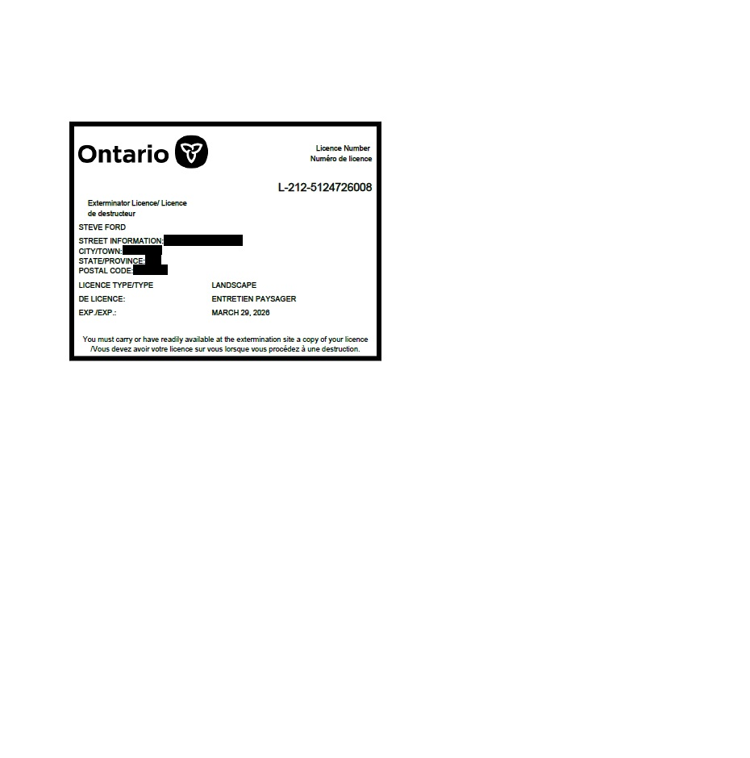
Qualifications- Landscape License

Slide 7

Qualifications- Aquatic License

Slide 8
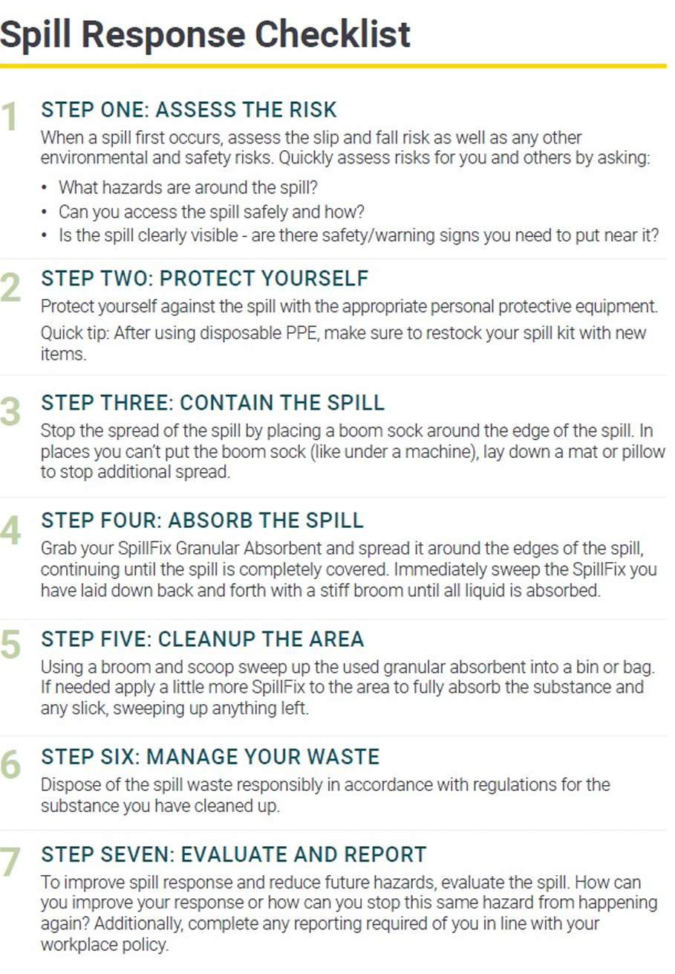

Slide 9
Traffsdjnvksjfnvkjjgjhgj

Slide 10
